Slide 1
Team Agile Robotic Controls
Logan Beaver
Justin Campbell
Tyler Paddock
Ronald Shipman

Slide 2
Project Overview
Develop initial robotics platform
Public Outreach
Increase interest in STEM fields
Engineering deficit
Educational robotics platform
Fluid Power
Control Systems

Slide 3
Major Design Decisions
Quadruped Locomotion
Agile motion
Stable
Rugged Terrain
Pneumatic Power
High energy density
Clean and lightweight

Slide 4
Mechanical Design

Slide 5
Pneumatic Design

Slide 6
Power Source Options
 | Advantages | Disadvantages
Hydraulic Power Source | -Highest achievable power density | -High maintenance -Heavy -Dirty
Electric Power Source | -Accurate positioning | -Lowest achievable power density -Noncompliant
Pneumatic Power Source | -Higher power density than electric power -Low Maintenance -Compliant action from fluid compression | -Compressible fluid causes inaccuracy in positioning

Slide 7
Components
Pneumatic components include:
Air Supply Tank
Air Compressor
Double Acting Air Cylinders (w/ feedback)
Receiver Tank
Solenoid Valve
Directional Control Valves (4/2)
Pressure Relief Valve
Tubing

Slide 8
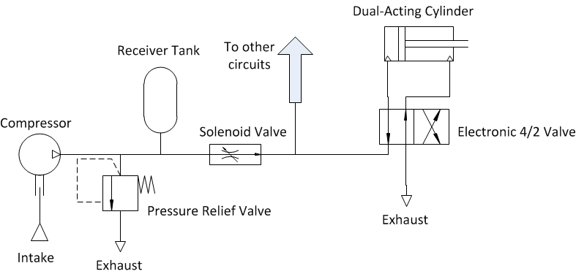
Pneumatic Circuit

Slide 9
What’s Next?
Determine necessary output forces of cylinders based on kinematic equations
Select appropriate pneumatic components based on needed specifications
Test air cylinders
Pneumatic circuit construction
Test circuit with control system

Slide 10
Simulation and Verification

Slide 11
Kinematic Modelling
Homogenous Transformations
Determines cylinder stroke

Slide 12
Dynamic Model
Lagrangian Mechanics
Non-inertial reference frames
Arbitrary grounded reference frame
Determines mechanical properties of components
27 Equations

Slide 13
Control architecture
Control algorithms (PIDs) implemented in software
Software used in this project is MATLAB, Simulink, and the associated CODER software
Simulink model of the control is developed and then C code is generated for the target hardware.
Current hardware is an Arduino Mega 2560

Slide 14
<Picture of Simulink model with PIDs>

Slide 15
Signal Conditioning
To drive the pneumatic actuators digital PWM signals from the microcontroller will be filtered by a low pass filter into analog signals
The analog signals will be scaled by amplifiers to the correct voltage required by the pneumatic actuator
Circuit isolation is needed to separate the 5 volt microcontroller circuit from the 12 volt actuator circuit
Circuit isolation will be achieved using opto-isolators
The feedback in the control loop will be a position feedback from the cylinder

Slide 16
User Interface
The robot will be remotely controlled by a human operator
Xbee short range radio devices using IEEE standard 802.15.4 will be used to handle the wireless communication
<Picture of controller, Xbee device, transmission medium, radio waves>

Slide 17
Questions?

